Slide 1
Advantages & Disadvantages of Therapeutic Approaches to Anxiety Disorders
ALYA REEVE, MD, MPH
9-8-2014
DDMI-TUG

Slide 2
Normal Anxiety
Alerting to danger
Protection
Attention – focus
Performance
Reactivity to CHANGE

Slide 3
Anxiety Disorder
Doesn’t give the nervous system a rest
Groups of disorders (changes in DSM-5)
GAD
Agoraphobia
Panic Disorder
OCD
OCPD
Obsessions
PTSD
Specific trauma
Acute traumatic experience

Slide 4
Therapeutic Opportunities
A. Internal Factors
Physiological responsiveness
Priming by past experiences
Age
Mindset; meaning
B. External Factors
Events
Ambience
Context
Frequency

Slide 5
Understanding the Internal Factors
Physiology
Parasympathetic nervous system
HR, pulse, BP; pupil dilation; increase blood flow to muscles
Tissue systems
Nervous; Muscular; Endocrine
Neurochemicals
Adrenaline; noradrenaline
Cortisol

Slide 6
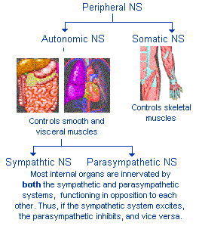
PNS

Slide 7
How do we modulate Internal Factors?
Direct
Block physiologic changes
beta- and alpha-blocking medications
raise/lower neurotransmitters
thyroid replacement/blocker
Carotid massage
Indirect
Hormones
Messages from CNS

Slide 8
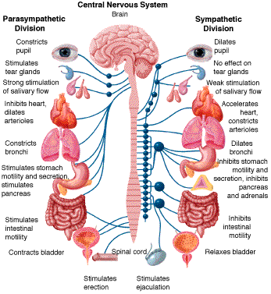
Sympathetic and Parasympathetic NS

Slide 9
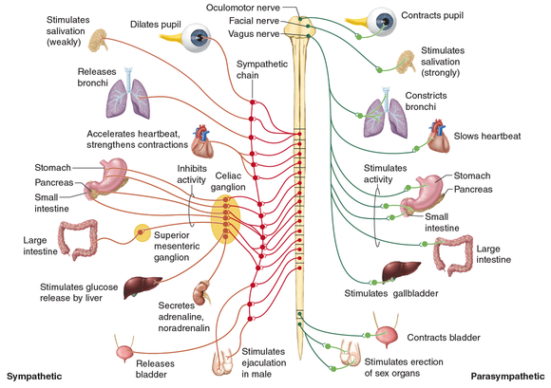
Sympathetic and Parasympathetic NS -2

Slide 10
Neurotransmitters
Ach = acetylcholine
N = nicotinic
M = muscarinic
NE = norepinephrine
Epi = epinephrine
D = delta

Slide 11
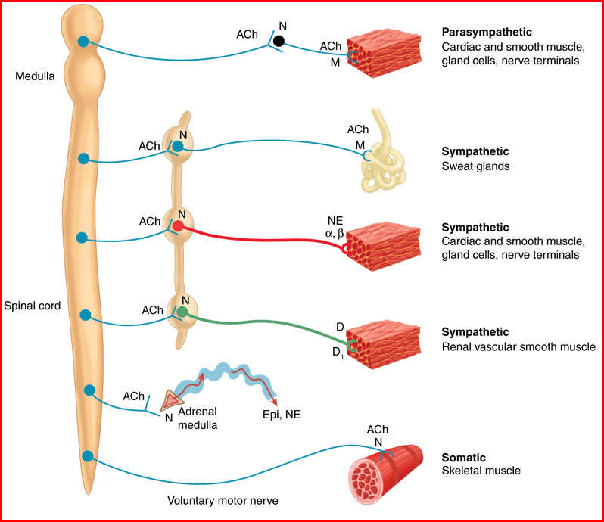
Neurotransmitters

Slide 12
ANS affects stress response hormone system
Cortisol
Regulation of levels
Effects on glucose metabolism
Sleep-wake cycle
Membrane integrity
Stress responses

Slide 13
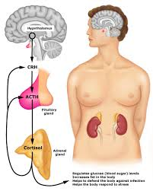
Cortisol – release & feedback

Slide 14
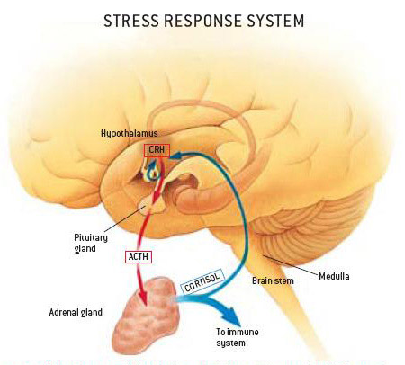
Responding to stressors -- cortisol

Slide 15
Short term & longer term responses

Slide 16
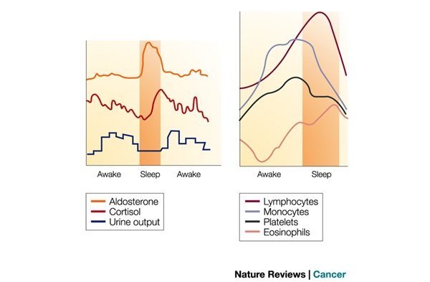
Diurnal variation -- cortisol

Slide 17
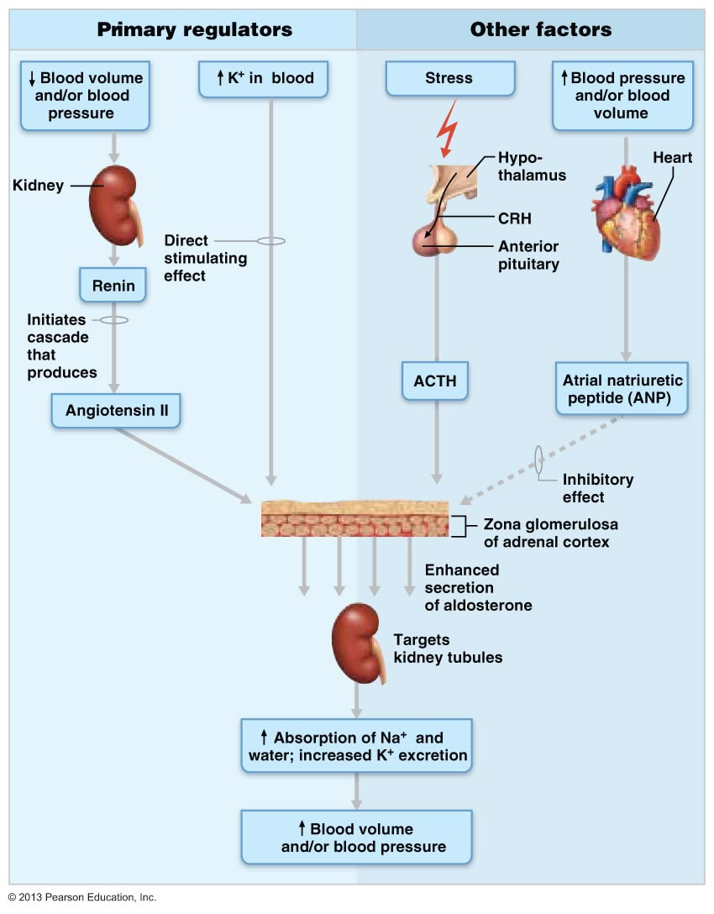
Multiple Ways to Affect the stress response system…

Slide 18
Need Different Ways to Modulate the ANS
Pharmacology
SSRI; TCA; SNRI; BZD; atypical neuroleptics; AED
Alcohol; opioids – less effective/more depressive; THC +/-
Complementary and Alternative Medicine
Acupuncture
Massage techniques
Mind – training: meditation; mindfulness
Nonverbal therapy
Art therapy
Music therapy
Somatic – directed psychotherapy

Slide 19
+/- modulating responses to stress
Exposure
Graded doses of stressor
Flooding – can be risky
Dietary changes/fads
Avoidance
Psychological defenses
Denial

Slide 20
Psychotherapies
Individual
Group
Many types: gender; experience; age
Open/closed; frequency; boundaries
Family
Cognitive-Behavioral
Dialectic-Behavioral

Slide 21
Developing a strategy
Assessment of primary and secondary symptoms
Careful understanding of meaning and etiology of Sx.
Individual strengths, weaknesses, preferences
What are local resources?
Using modalities long enough to have an effect
Too short to have effect is not a trial
Too long is an unbroken habit
Re-examine change/progress at regular intervals

Slide 22
Conclusions
Anxiety may need to be treated
Pharmacology may not be best treatment for an individual
Silence does not mean effective end point reached
Combination of traditional and complementary techniques usually most effective
Individual variation is the norm
Thank you for your attention & participation!

